Slide 1

Kuali Nervous System
Notes:
Include team in introductions - Rice/KFS

Slide 2

Outline
What is the Kuali Nervous System?
Where did it come from?
What does it do?
And, what's Rice got to do with this?

Slide 3
What is the KNS?
KNS = Kuali Nervous System
An application development framework that KFS and KRA are built on
Focuses on providing a foundation for efficient development of business functionality
Helps to ensure consistent development practices
Notes:
Probably should add more about the framework:
* document-centric (everything's a doc)
* integration with workflow

Slide 4
History of the KNS
KFS spent a large amount of development time up front, using the best talent from each of the partner institutions
Came up with a foundation on which to build KFS - the Kuali Nervous System
It focused on a unified approach to development of functionality
  A standard way to use workflow, perform CRUD operations, handle business transactions
KNS extracted from KFS and put into Rice as a module

Slide 5
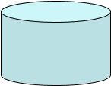










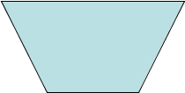
Understanding the KNS Paradigm
ORM
Mapping
Entity
(POJO)
ENTITY_T
Data Dictionary
Lookups and Inquiries
Maintenance
Documents
Transactional
Documents
Workflow
(KEW)

Slide 6
Data Dictionary
Business Objects
  Attributes
  Lookups
  Inquiries
  Relationships
Document Definitions
  Sections
  Fields
  Collections
Notes:
Only describe the DD's features here. We'll get into the XML in a later slide.

Slide 7
Modules
Modules define a subset of functionality within your application.
Can be used to control access.
Used to specify the location of various configuration files.
Notes:
On a simple app will most likely have only one.
Specifies location of configuration files
KFS examples of modules: Purchasing, AR, Budget Construction etc...

Slide 8

Module XML
<bean id="chartModule" class="org.kuali.core.KualiModule">
<property name="moduleId" value="chart" />
<property name="moduleName" value="Chart Of Accounts" />
<property name="moduleCode" value="CA" />
<property name="moduleUserService" ref="chartUserService" />
<property name="initializeDataDictionary" value="true" />
<property name="moduleUserRule">
<bean class="org.kuali.module.chart.rules.ChartUserRule" singleton="false" parent="maintenanceDocumentRuleBase" />
</property>
<property name="moduleAuthorizer">
<bean class="org.kuali.kfs.authorization.KfsModuleAuthorizerBase">
<property name="packagePrefixes">
<list>
<value>org.kuali.module.chart.</value>
</list>
</property>
</bean>
</property>
...

Slide 9
Module XML
...
<property name="dataDictionaryPackages">
<list>
<value>org/kuali/module/chart/datadictionary</value>
</list>
</property>
<property name="databaseRepositoryFilePaths">
<list>
<value>org/kuali/module/chart/OJB-repository-chart.xml</value>
</list>
</property>
<property name="scriptConfigurationFilePaths">
<list>
<value>org/kuali/module/chart/dwr-chart.xml</value>
</list>
</property>
<property name="jobNames">
<list>
<value>fiscalYearMakerJob</value>
</list>
</property>
</bean>

Slide 10
Business Objects
Attributes
  Labels
  UI Widgets
  Validation
Lookups
Inquiries
Relationships

Slide 11
Persistence Framework
Business Objects
Collections
Security
  Field Encryption
  Masking
Extendable
Notes:
JHK: This slide needs to be re-worked.

Slide 12
Maintenance Documents
They do not need to be built case by case - just one JSP draws them all
Designed originally to handle simple table update situations. They can now handle nested data.
Base behavior is to directly save the object(s) being edited upon final approval.
Examples include:
  Campus Code Maintenance Document
  Universal User Maintenance Document
  System Parameter Maintenance Document

Slide 13
Transactional Documents
These are data-entry centric documents or “transactions” that model the business processes
Examples include: Auxiliary Voucher, Requisition, Distribution of Income and Expense
Built on a case by case basis using the Kuali Rice tag libraries (encompass snippets of UI behavior):
  Notes and attachments
  Workflow route log (audit log)
Integrated with workflow

Slide 14
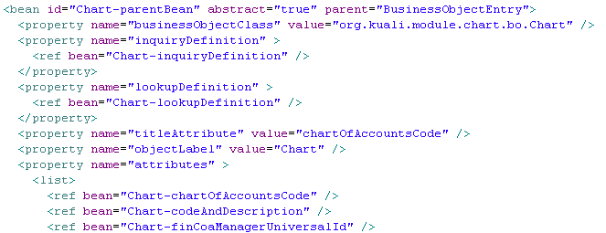
Business Object XML

Slide 15
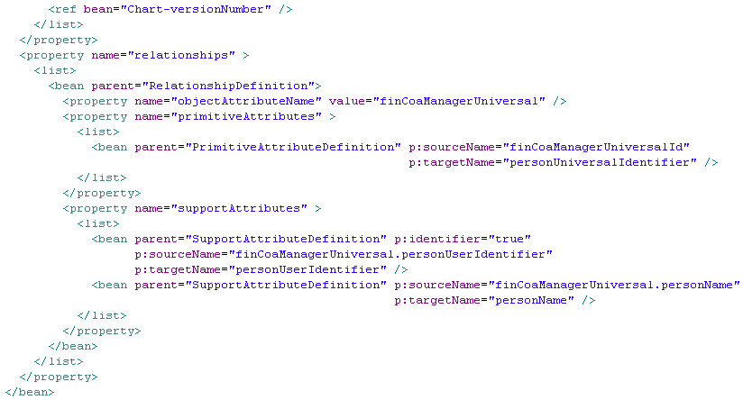
Business Object XML (2)

Slide 16
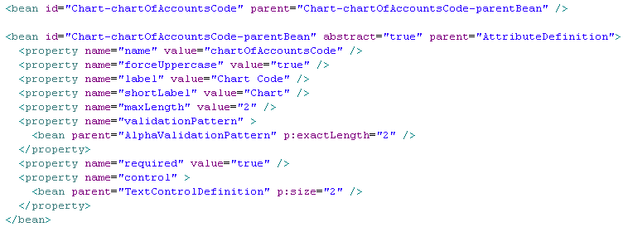
Business Object Attribute XML

Slide 17

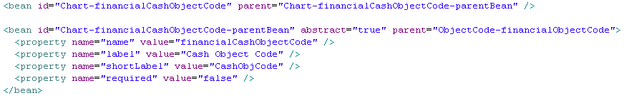
Business Object Attribute XML (2)

Slide 18
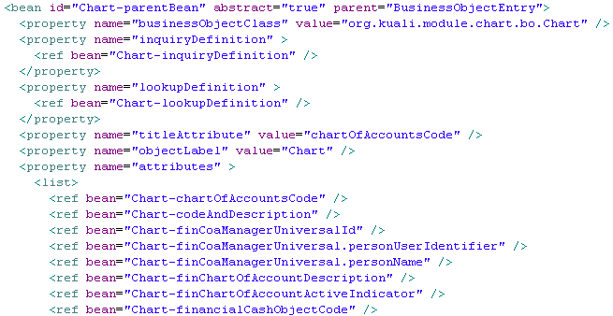
Business Object Attribute XML (3)

Slide 19
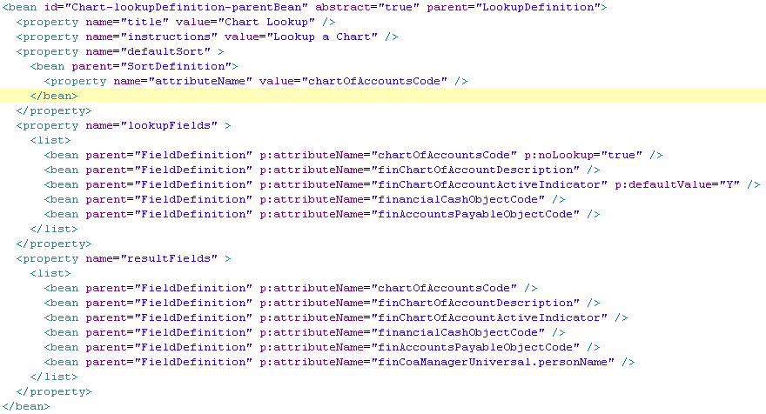
Lookup DD Sample

Slide 20
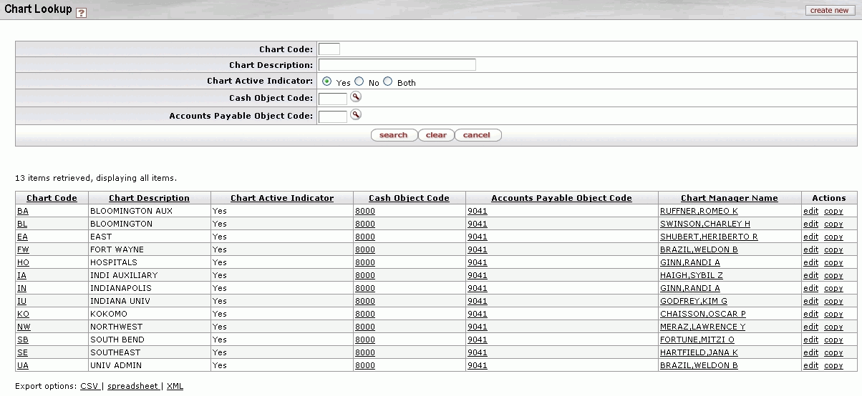
Lookups
  A way to search for data by a set of criteria
  Results of lookups can be returned to other lookups or documents

Slide 21
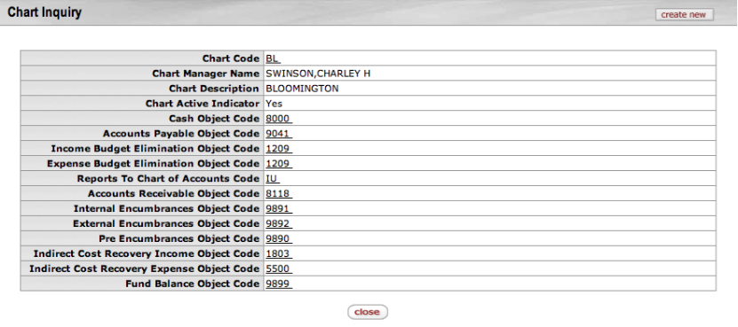
Inquiries
A way to drill down and get more read-only information about a table record

Slide 22
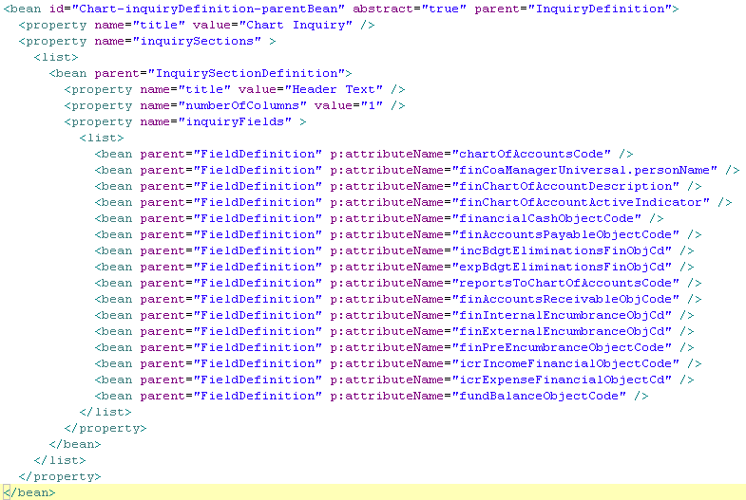
Inquiry DD Sample

Slide 23
Business Rules
Rules
  onSave
  onRoute
  onApprove
  onAddLine
Pre-Rules
  Can ask questions

Slide 24
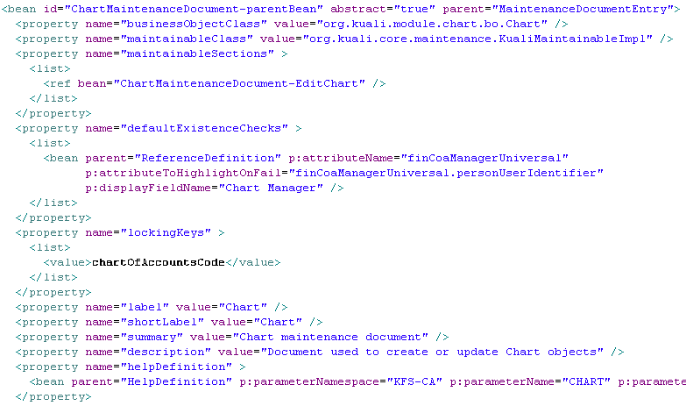
Maint. Document XML

Slide 25
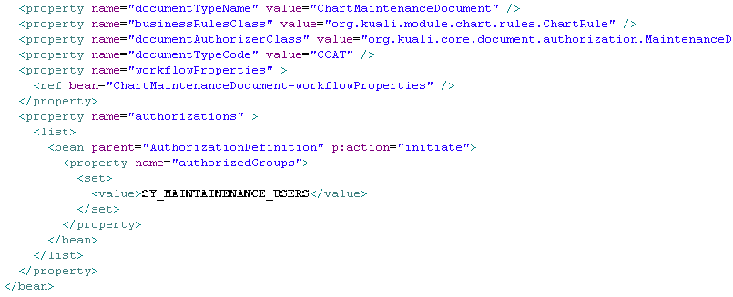
Maint. Document XML

Slide 26
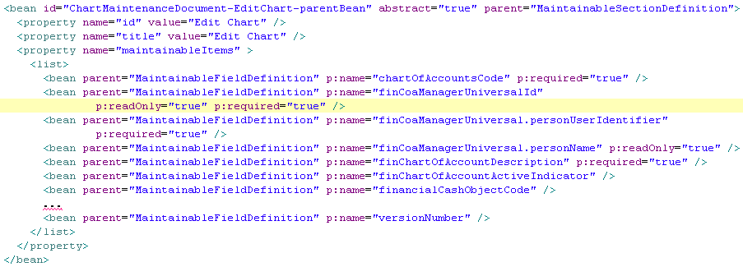
Maint. Document XML

Slide 27
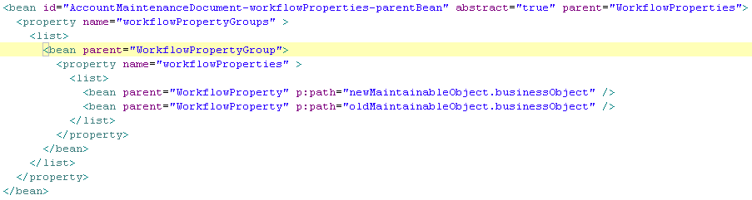
Maint. Document XML

Slide 28
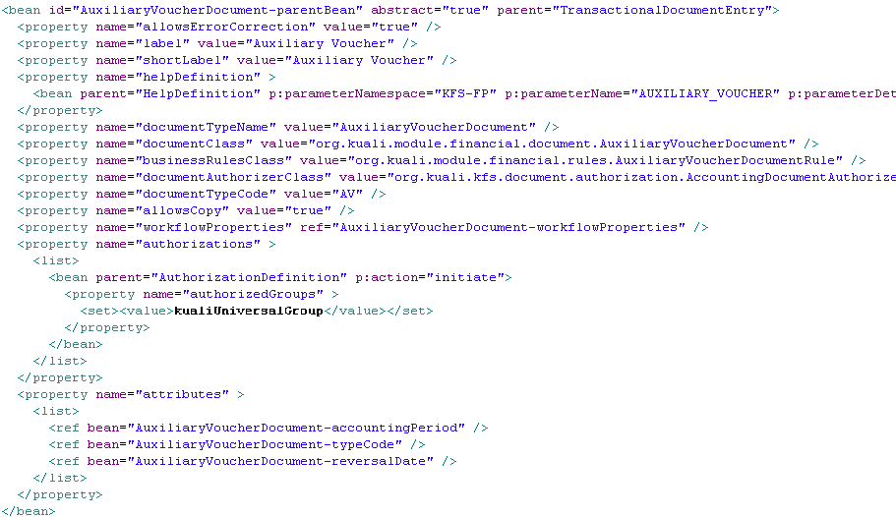
Trans. Document XML

Slide 29
Authorization/Security
Module Level
Document Level
Field Level
  Read Only Fields
  Hidden Fields
  Masked Fields

Slide 30
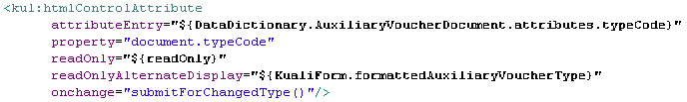
Custom Tag Library
<kul:htmlControlAttribute> - Displays a Widget based on the DD
<kul:htmlControlLabel> - Outputs the label for a given attribute.
<kul:tab> - Container tag representing a section of a document

Slide 31
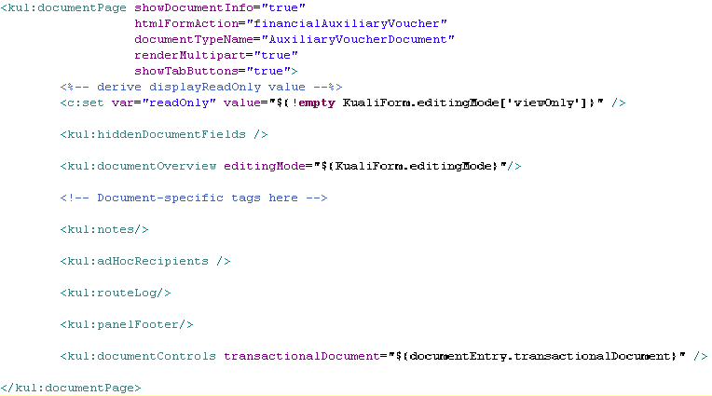
Custom Tag Library

Slide 32
Other KNS Features
System parameters
Extended attributes

